Slide 1
USAGE BASED PRICING MODELS
STUDENT 1- 212FT116-SWETHA G STUDENT 2- 212FT114-SONIYA B
STUDENT 3- 212FT119-VYSHYA R
STUDENT 4- 212FT104-DHARSANA S

Slide 2
ABSTRACT:
Usage based pricing allows customers to pay for products based on the consumption that they do. This kind of pricing helps the customer to start from the low cost and then attract more customers to get started while still preserving the ability to monetize a customer over time. ‘Usage based pricing will be the key to successful monetization in the future’. Transitioning to a fully usage based model can be as seismic of a shift as going from on prem.

Slide 3
PROBLEM STATEMENT ADDRESSED:
PROBLEM 1: Sticker shock that can cause customer dissatisfaction – can degrade customers experience.
PROBLEM 2: Low switching costs-allows users to switch software.

Slide 4
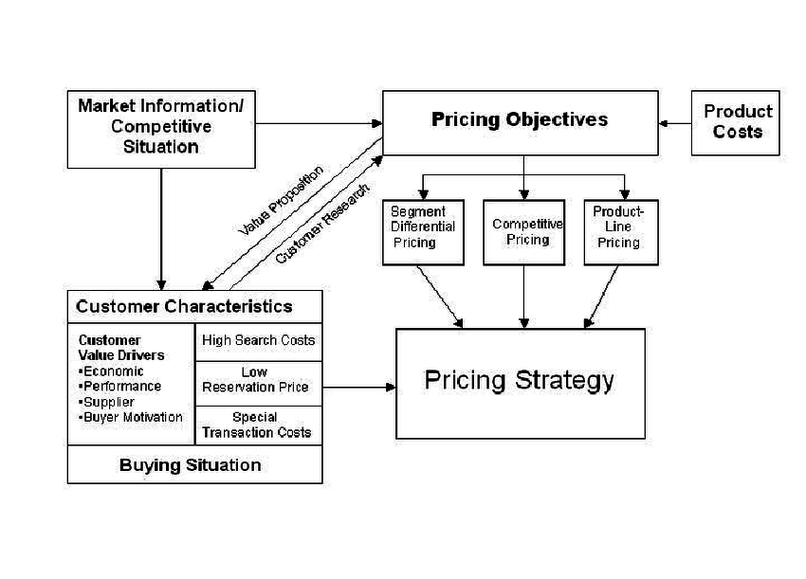
BLOCK DIAGRAM:

